Slide 1
Attend and Diagnose: Clinical Time Series Analysis using Attention Models Huan Songy, Deepta Rajanz , Jayaraman J. Thiagarajanyy, Andreas Spanias Xiaohan Cheng Sept 30, 2021

Slide 2
Background
With widespread adoption of electronic health records, there is an increased emphasis for predictive models that can effectively deal with clinical time-series data.
Despite the success of RNNs, its sequential nature prohibits parallelized computing, thus making it inefficient particularly when processing long sequences.
The classical approach for healthcare data analysis has been centered around extracting hand-engineered features and building task-specific predictive models.
Notes:
Powered by Recurrent Neural Network (RNN) architectures with Long Short-Term Memory (LSTM) units, deep neural networks have achieved state-of-the-art results in several clinical prediction tasks.

Slide 3
Solution
Utilize attention models for clinical time-series modeling, dispensing recurrence entirely.
Develop the SAnD (Simply Attend and Diagnose) architecture, which employs a masked, self-attention mechanism, and uses positional encoding and dense interpolation strategies for incorporating temporal order.
Develop a multi-task variant of SAnD to jointly infer models with multiple diagnosis tasks.
Using the recent MIMIC-III benchmark datasets to demonstrate that the proposed approach achieves state-of-the-art performance in all tasks.
Outperforming LSTM models and classical baselines with handengineered features.
Notes:
Recently, architectures which are based solely on attention mechanisms have shown remarkable success in transduction tasks
in NLP, while being computationally superior.

Slide 4
Motivation for Using Attention Models
Memory: While LSTMs are effective in sequence modeling, lengths of clinical sequences are often very long and in many cases they rely solely on short term memory to make predictions. Attention mechanisms will enable us to understand the amount of memory modeling needed in benchmark tasks for medical data;
Optimization: The mathematical simplicity of attention models will enable the use of additional constraints, e.g. explicit modeling of correlations between different measurements in data, through inter-attention
Computation: Parallelization of sequence model training is challenging, while attention models are fully parallelizable.

Slide 5
SAnD (Simply Attend and Diagnose) Architecture
Architecture is inspired by the recent Transformer model for sequence transduction.
The Transformer architecture achieves superior performance on machine translation benchmarks, while being significantly faster in training when compared to LSTM-based recurrent networks.
In contrast to state-of-the-art approaches, this does not utilize any recurrence or convolutions for sequence modeling.

Slide 6
Input Embedding
The first step is to generate an embedding that captures the dependencies across different variables without considering the temporal information.
This is conceptually similar to the input embedding step in most NLP architectures, where the words in a sentence are mapped into a high-dimensional vector space to facilitate the actual sequence modeling.
Notes:
To this end, we employ a 1D convolutional layer to obtain the d-dimensional (d > R) embeddings for each t.

Slide 7
Positional Encoding
Include information about the relative or absolute position of the time-steps in the sequence.
Add positional encodings to the input embeddings of the sequence.
The encoding is performed by mapping time step t to the same randomized lookup table during both training and prediction.
The d-dimensional positional embedding is then added to the input embedding with the same dimension.
Notes:
architecture contains no recurrence, in order to incorporate information about the order of the sequence,
Note that, there are alternative approaches to positional encoding. However, the proposed strategy is highly effective in all our tasks.

Slide 8
Attention Module
Self-attention, also referred as intra-attention, is designed to capture dependencies of a single sequence.
SAnD relies almost entirely on self-attention mechanisms.
Restricted self-attention that imposes causality, i.e., considers information only from positions earlier than the current position being analyzed.
Notes:
Self-attention has been used successfully in a variety of NLP tasks including reading comprehension and abstractive summarization.
depending on the task we also determine the range of dependency to consider.
For example, phenotyping tasks require a longer range dependency compared to mortality prediction.

Slide 9

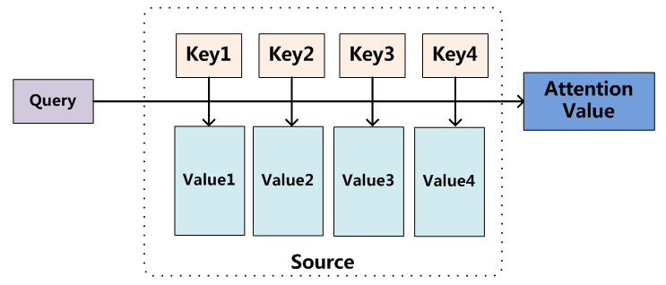
Attention Function
An attention function can be defined as mapping a query q and a set of key-value pairs {k, v} to an output o.
compute o as weighted combination of the value vectors
pass o through a feed-forward network to obtain the vector representation for t

Slide 10

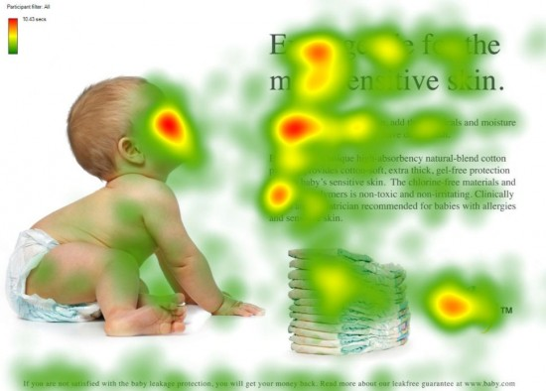
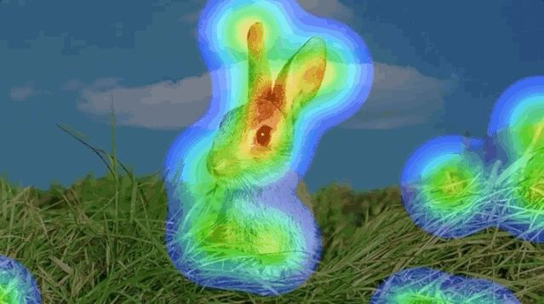
Attention Function
An attention function can be defined as mapping a query q and a set of key-value pairs {k, v} to an output o.
Q, K, V are the matrices formed by query, key and value vectors
d is the dimension of the key vectors.

Slide 11
Self-Attention
Masked self-attention: Mask the sequence to specify how far the attention models can look into the past for obtaining the representation for each position.
Self-attention creates a graph structure for the sequence, where edges indicate the temporal dependencies.
Stack the attention module N times and perform the actual prediction task using representations obtained at the final attention module.
There is a need to create a concise representation for the entire sequence using the learned representations, for which we employ a dense interpolated embedding scheme, that encodes partial temporal ordering.
Notes:
They actually create multiple attention graphs.
each attention graph is defined by different parameters. Each of these attention graphs can be interpreted to encode different types of edges and hence can provide complementary information about different types of dependencies. Hence, we use “multi-head attention” where 8 heads are used to create multiple attention graphs and the resulting weighted representations are concatenated and linearly projected to obtain the final representation.

Slide 12
Dense Interpolation Embedding
The simplest approach to obtain a unified representation for a sequence, while preserving order, is to concatenate embeddings at every time step. This lead to a very high-dimensional representation which is not suitable for learning and inference.
Utilize a dense interpolation algorithm from language modeling.
Dense interpolation embeddings, along with the positional encoding module, are highly effective in capturing enough temporal structure required for even challenging clinical prediction tasks.
Notes:
The simplest approach to obtain a unified representation for a sequence, while preserving order, is to simply concatenate embeddings at every time step. However, in our case, this can lead to a very high-dimensional, “cursed” representation which is not suitable for learning and inference.

Slide 13
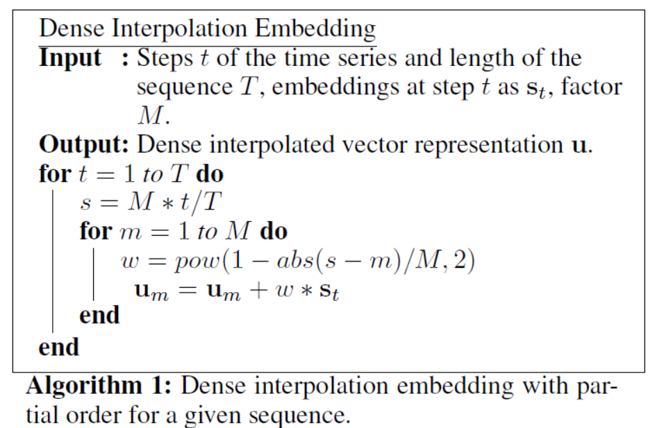
Dense Interpolation Embedding
S_{t}: the hidden representation at time t from the attention model
M: the dense interpolation factor.
S: the relative position
The interpolated embedding vector dimension d × M
when M = T, it reduces to the concatenation case.
Main idea: determine weights w, denoting the contribution of S_{t} to the position m of the final vector representation u.
Notes:
The pseudocode to perform dense interpolation for a given sequence is shown in Algorithm 1.
S the relative position of time step t in the final representation u

Slide 14
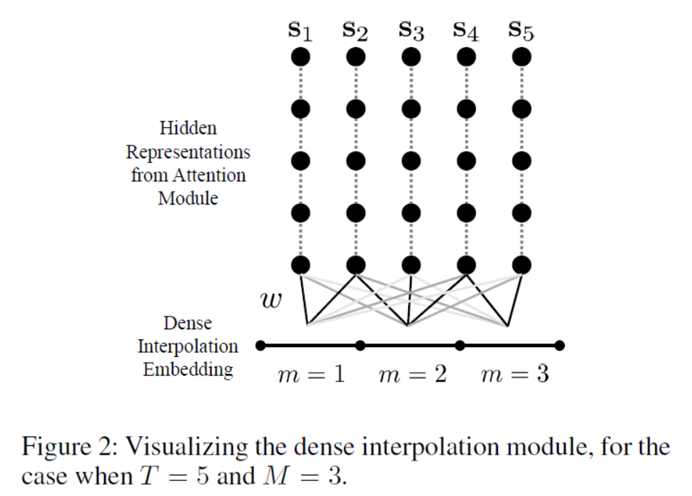
Dense Interpolation Embedding
Notes:
They visualize the dense interpolation process in Figure 2 for the toy case of T = 5;M = 3
The larger weights in w are indicated by darker edges while the lighter edges indicates lesser influence.

Slide 15
Linear and Softmax layers
Utilize a linear layer to obtain the logits. The final layer depends on the specific task.
A softmax layer for the binary classification problems
A sigmoid layer for multi-label classification since the classes are not mutually exclusive
A ReLU layer for regression problems.
Notes:
After obtaining a single vector representation from dense interpolation,

Slide 16
Regularization
Apply dropout to the output of each sub-layer in the attention module prior to residual connections and normalize the outputs.
Include an additional dropout layer after adding the positional encoding to the input embeddings
Perform attention dropout after computing the self-attention weights.
Notes:
After obtaining a single vector representation from dense interpolation,

Slide 17
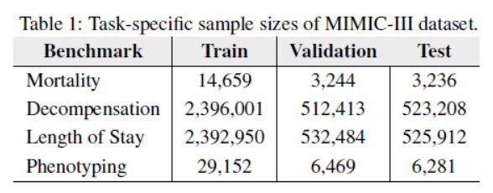
MIMIC-III Benchmarks & Formulation
The MIMIC-III database consists of de-identified information about patients admitted to critical care units between 2001 and 2012
It encompasses an array of data types such as diagnostic codes, survival rates, and more.
Notes:
They use the cohort of 33798 unique patients with a total of 42276 hospital admissions and ICU stays.

Slide 18
MIMIC-III Benchmarks & Formulation
In Hospital Mortality
This problem is posed as a binary classification one where each data sample spans a 24-hour time window.
Decompensation: deterioration of organ functionality during hospitalization.
Predicting if a patient would die within the next 24 hours by continuously monitoring the patient within fixed time-windows.
Notes:
In Hospital Mortality is defined as the outcome of whether a patient dies during the period of hospital admission or lives to be discharged.
Decompensation requires prediction at each time-step. True decompensation labels were curated based on occurrence of patient’s DOD within the next 24 hours,

Slide 19
MIMIC-III Benchmarks & Formulation
Length of Stay
Such an estimation is carried out by analyzing events occurring within a fixed time-window, once every hour from the time of admission.
Phenotyping
Given information about a patient’s ICU stay, one can retrospectively predict the likely disease conditions.
Multi-label classification problem
Notes:
These true range of values were then transformed into ten buckets to repose this into a classification task, namely: a bucket for less than a day, seven one day long buckets for each day of the 1st week, and two outlier buckets-one for stays more than a week but less than two weeks, and one for stays greater than two weeks
The benchmark dataset deals with 25 disease conditions of which 12 are critical such as respiratory/renal failure, 8 conditions are chronic such as diabetes, atherosclerosis, and 5 are ’mixed’ conditions such as liver infections. Typically, a patient is diagnosed with multiple conditions and hence this can be posed as a multi-label classification problem.

Slide 20
Applying SAnD to MIMIC-III Tasks
Size of the self-attention mask (r)
Dense interpolation factor (M)
The number of attention blocks (N)
Experiments show that smaller mask sizes are sufficient to capture all required dependencies in 3 out of 4 tasks, except phenotyping, which needed modeling of much longer-range dependencies
Notes:
In order to solve the benchmark tasks with SAnD, need to make a few key parameter choices for effective modeling.

Slide 21
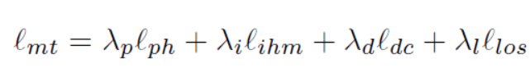
Multi-task Learning
In several recent results from the deep learning community, it has been observed that joint inferencing with multiple related tasks can lead to superior performance in each of the individual tasks, while drastically improving the training behavior.
Implemented a multi-task version of SAnD, SAnD-Multi, which uses a loss function that jointly evaluates the performance of all tasks
The input embedding and attention modules are shared across the tasks, while the final representations and the prediction layers are unique to each task.
Notes:
correspond to the losses for the four tasks.
Our approach allows the use of different mask sizes and interpolation factors for each task, but requires the use of the same N

Slide 22
Performance Evaluation
Evaluate the proposed SAnD framework on the benchmark tasks
State-of-the-art RNNs based on LSTM
Baseline logistic regression (LR)
Notes:
evaluate the proposed SAnD framework on the benchmark tasks and present comparisons to the stateof-the-art RNNs based on LSTM and baseline logistic regression (LR) with hand-engineered features.

Slide 23
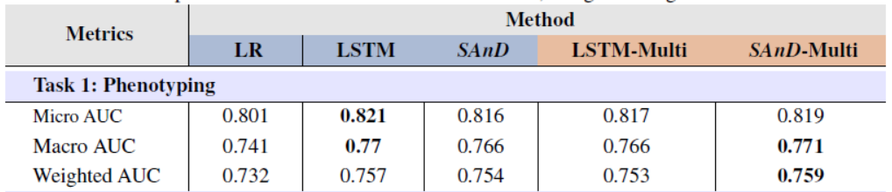
Single-Task Case: Phenotyping
Macro-averaged Area Under the ROC Curve (AUROC), which averages per-label AUROC,
Micro-averaged AUROC, which computes single AUROC score for all classes together
Weighted AUROC, which takes disease prevalence into account.

Slide 24
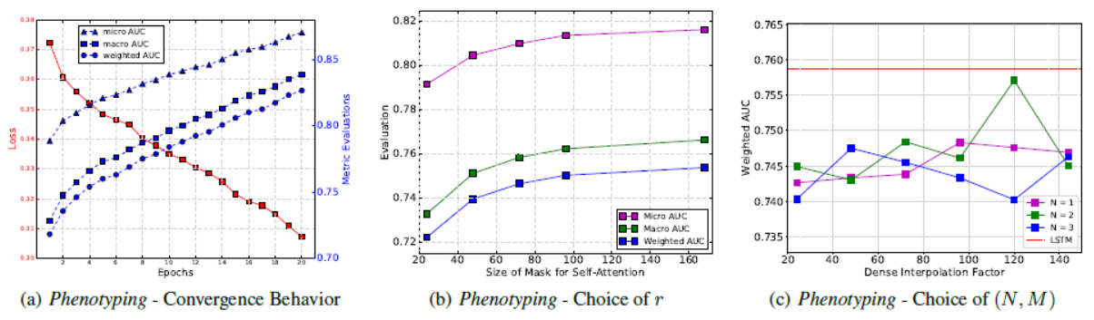
Single-Task Case: Phenotyping
Using a grid search on the parameters N (number of attention layers) and M (dense interpolation factor)
N = 2 and M = 120 produced the best performance
Highly competitive to the state-of-the-art results.

Slide 25
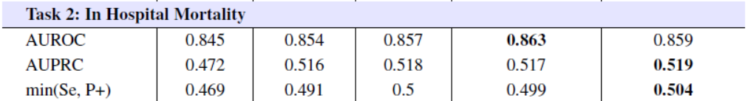
Single-Task Case: In Hospital Mortality
AUROC
AUPRC
Minimum of precision and sensitivity (Min(Se, P+))
SAnD outperforms both the baseline methods
Notes:
sensitivity identifies the rate at which observations from the positive class are correctly predicted.
precision indicates the rate at which positive predictions are correct.

Slide 26
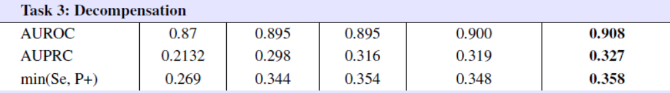
Single-Task Case: Decompensation
AUROC
AUPRC
Minimum of precision and sensitivity (Min(Se, P+))
SAnD outperforms both the baseline methods
Significantly more efficient for training on this large-scale data when compared to an LSTM model
Notes:
Area under Receiver Operator Curve (AUROC)
Area under Precision-Recall Curve (AUPRC)

Slide 27
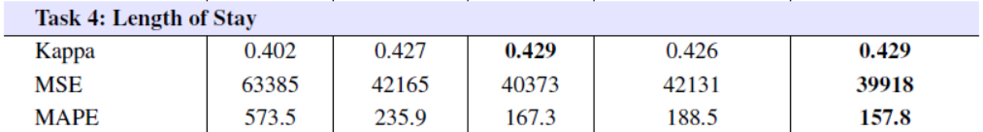
Single-Task Case: Length of Stay
Cohen’s linear weighted kappa metric
mean squared error(MSE)
mean absolute percentage error (MAPE)
SAnD outperforms both the baseline methods

Slide 28
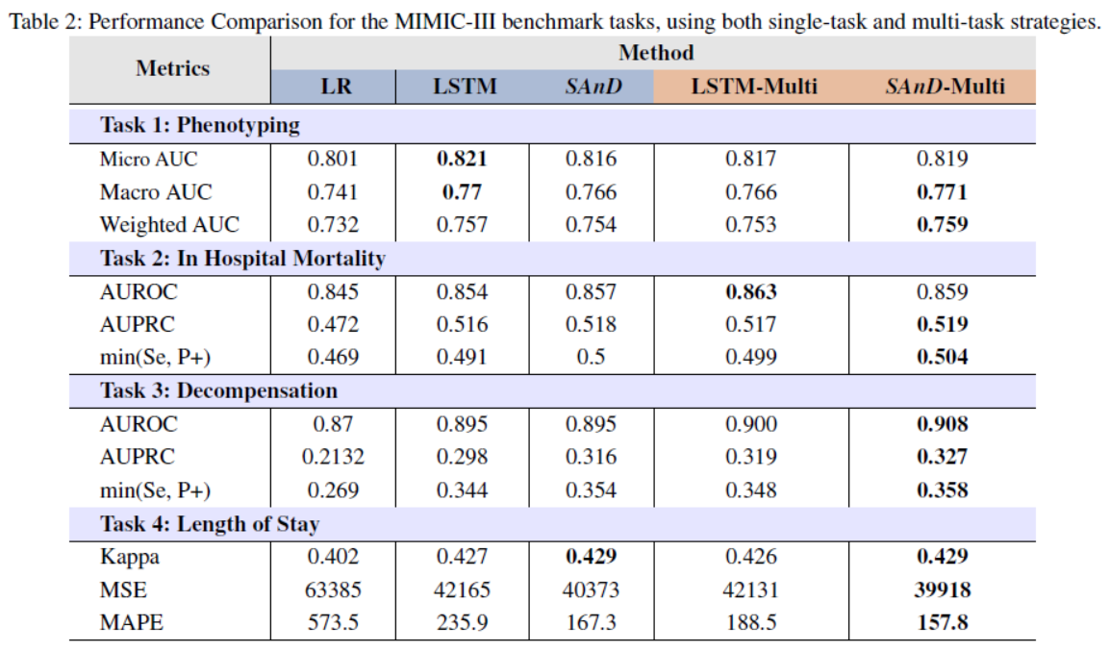
Multi-Task Case
Notes:
produces the best performance in almost all cases, with respect to all the evaluation metrics.
Interestingly, in the multi-task case, the best results for phenotyping were obtained with a much lower mask size (72), thereby making the training more efficient.
The set of hyperparameters were set at batch size = 128, learning rate = 0:0001, N = 2, M = 36 for phenotyping and M = 12 for the other three cases.

Slide 29
Thank you
Any questions?

